Slide 1
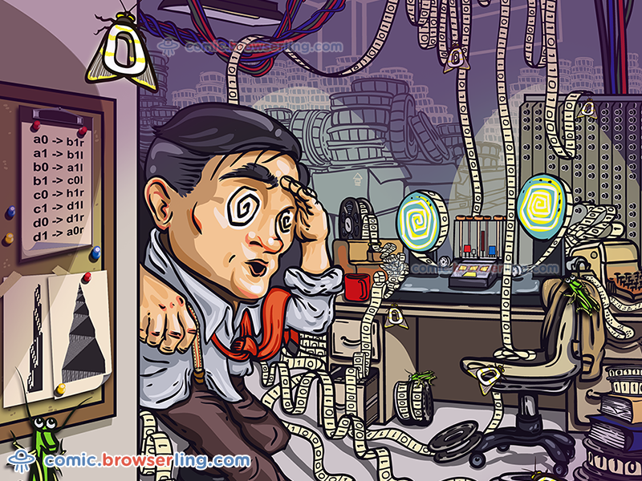
Part II Computability Theory
decidability

Slide 2
Agenda
Undecidability
Diagonalization Method
Example of an undecidable language
Turing unrecognizable language

Slide 3
Undecidability
Unsolvable problems are not necessarily esoteric. Some ordinary problems that people want to solve may turn out to be unsolvable.
For example, the general problem of software veriﬁcation is not solvable by computer.
The speciﬁc problem that we will prove algorithmically unsolvable is the one of testing whether a Turing machine accepts a given input string.

Slide 4
The Acceptance Problem for TM
A_{TM} = {<M, w> | M is a TM and M accepts w}
Undecidable ????

Slide 5
Proof
U= “On input <M, w>, where M is a TM and w is a string:
1. Simulate M on input w.
2. If M ever enters its accept state, accept ; if M ever enters its
reject state, reject.”
Note: The Turing machine U is an example of the universal Turing machine, as it is capable of simulating any other Turing machine from the description of that machine.
However, ATM is Turing-recognizable.

Slide 6
Diagonalization Method
George Cantor 1873
Concerned with the problem of measuring infinite sets
If two infinite sets which one is larger
Pairing of finite sets can be extended to infinite sets

Slide 7
Some Preliminaries
1. Given two sets A and B, a function f : A → B is called one-to-one, if ∀x, y ∈ A, x <>y, f(x) <> f(y)
2. Given two sets A and B, a function f : A → B is called onto,
If ∀y ∈ B, ∃x ∈ A, f(x) = y
3. Two sets A and B are called of the same size, or of the same cardinality, if there exists a one-to-one, onto function f : A → B.

Slide 8
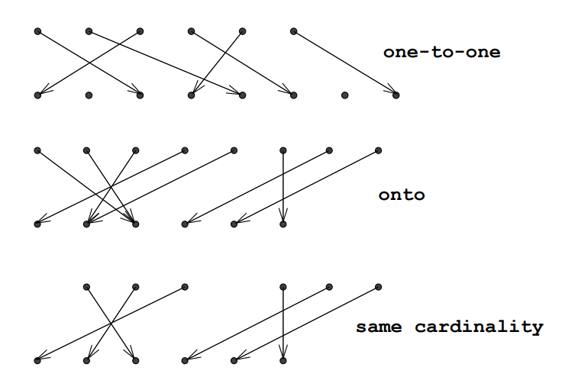
Some Preliminaries
Injective
Surjective
Bijective

Slide 9
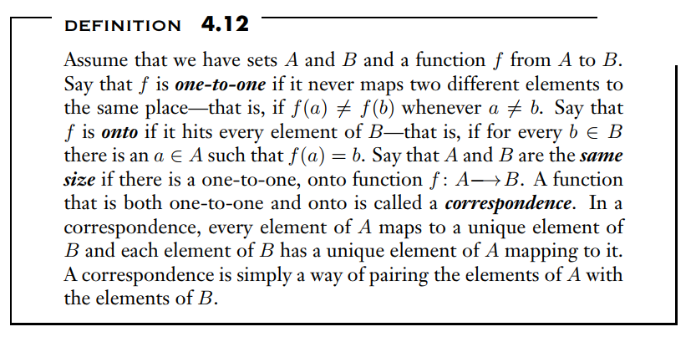

Slide 10
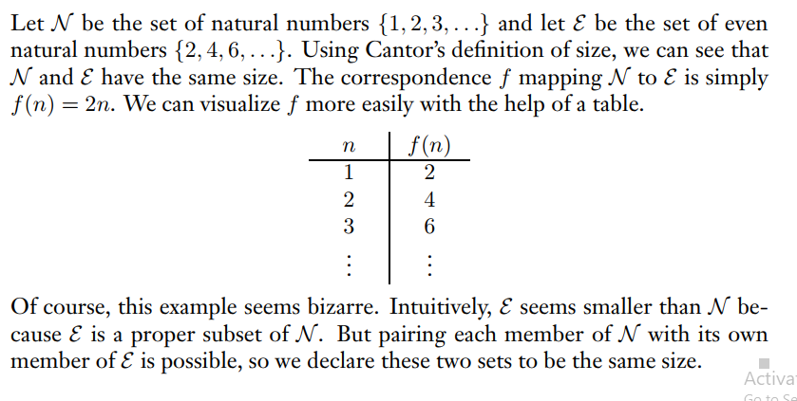
Example 4.13

Slide 11
Countable vs. Uncountable
A set A is countable if either it is ﬁnite or it has the same size as N = {1, 2, 3, · · ·}
It is uncountable, otherwise.
Let Q be the set of positive rational numbers. Then Q is countable.

Slide 12
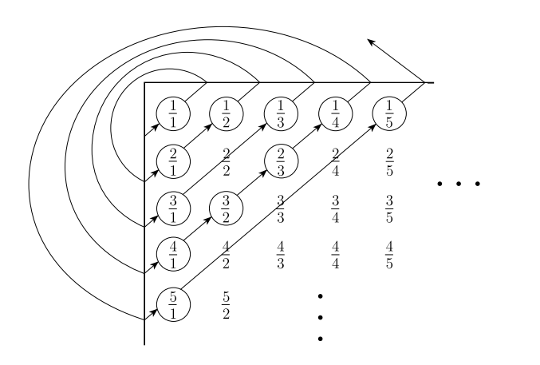
Proof Q is countable

Slide 13
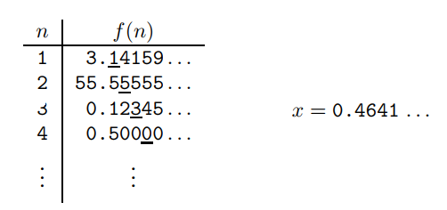
Uncountable sets
A real number is one that has a (possibly inﬁnite) decimal representation.
Let R be the set of real numbers. R is uncountable.
Assume that a correspondence f existed between N and R.
We can ﬁnd an x, 0 < x < 1, so that the
i-th digit following the decimal point of x is diﬀerent
from that of f (i); for example, x = 0.4641 · · ·
is a possible choice.

Slide 14
Existence of Turing-unrecognizable Languages
The main claim of this section is that there are languages that are not accepted by any Turing machine.
The method by Cantor is used for counting, or measuring inﬁnite sets.
It turns out there are diﬀerent kinds of inﬁnite sets although there are inﬁnite number of TMs and an inﬁnite number of languages, still there are more languages than Turing machines.

Slide 15
Application of Cantor’s set Theory to Turing Computation
Corollary 4.18: Some Languages are not Turing-recognizable
Proof:
Since every Turing machine can be encoded as a ﬁnite string over a ﬁnite alphabet
Q ∪ Σ ∪ Γ ∪ {R, L},
The set of all Turing machines is countable.
On the other hand, every language over Σ is uniquely described as an inﬁnite 0,1-sequence. Indeed, let the countable set of all ﬁnite strings over Σ be w1, w2, w3, . . ..
Then, a language L ⊆ Σ∗ is given by a sequence (δ1, δ2, . . .), where δi = 1 if wi ∈ L.
Since the set of 0,1-sequences is uncountable and the set of Turing machines is countable, we obtain the result.

